Slide 1
CHAPTER 5 Predictive Control with constraints 13 MCAS for dual-mode approaches with tracking
Anthony Rossiter

Slide 2
Background
The previous video explained the need to put limits on the allowable target to ensure that the steady-state was feasible.
This video considers a procedure for forming the MCAS which can be done offline and just once even though the targets/disturbances may change within the given limits.
We will use absolute variables rather than deviation variables, but the approach is still fundamentally the same as in videos 9,10.

Slide 3
Requirements on targets
The steady-state must lie in the interior of the set.
SEE previous video
Users should check their targets against these inequalities before deploying.
Or set limits on r-d if more appropriate.

Slide 4
Predictions in absolute values
The predictions in terms of absolute values.

Slide 5
Autonomous model formulation
Autonomous model for prediction which includes the target/disturbance estimate as an extra state:

Slide 6
Typical constraints
Using absolute values.

Slide 7
Combined constraints
Because we assume the value r-d is constant, these rows will not be carried forward in any admissible set iteration.

Slide 8
Illustration of admissible set
The separation of constraints into ones that do not change and ones that do is easy to implement.
The final set will look something like this.
NOTE THAT:

Slide 9
Summary
The stable model takes the form:
Constraints at each sample can be re-arranged into the form:
The asymptotic point is in the interior.
MAS code for split inequalities is in findmas_tracking.m
We can apply a standard admissible set algorithm to determine the MCAS.
G2 constraints do not change so do not include in iteration.

Slide 10
Maximal controlled admissible set
The MCAS is given from:
This can be expanded to:
Or:
Clearly the shape of the MCAS is closely linked to the current target and disturbance estimate.
Reference governors exploit this observation.

Slide 11
WARNING
The MATLAB code provided for determining the MCAS in findmas_tracking.m is simple and transparent but by no means efficient.
For slow systems, large numbers of states and so on, viewers are recommended to source more efficient code for handling inequalities.
At the very least one needs an effective mechanism for removing redundant constraints – this is covered next.

Slide 12
MATLAB code
In OMPC folder.
MAIN CODE is chap5_ompc_simulate_constraintsc.m
ALSO findmas_tracking.m
KEY EXAMPLES ARE IN video5_13_example1.m and video5_13_example2.m
(The latter is very slow as MCAS has a large number of rows and coding inefficient).
If the limits on r-d are generous, one may need a very large prediction horizon to capture the MCAS.

Slide 13
video5_13_example1.m
SISO but slow closed-loop dynamic.

Slide 14
video5_13_example2.m
MIMO, slow to converge. Very large number of inequalities (1644!) in
Very large number of rows likely to be linked to the freedom in r and d which means one needs to get close to asymptotic values to capture the MCAS.

Slide 15
Summary
This video has shown how a single MCAS can be constructed for the OMPC/SOMPC algorithm for a time varying targets/disturbances.
This MCAS is based on an augmented state which includes the ‘target’ steady-state.
This target must be reachable, and also feasible during transients with the given n_{c} so convergence requires inclusion of appropriate limits.
The code is not efficient and convergence is poor or fails if limits on r-d chosen poorly.
Ensuring feasibility is beyond the remit of this chapter.

Slide 16



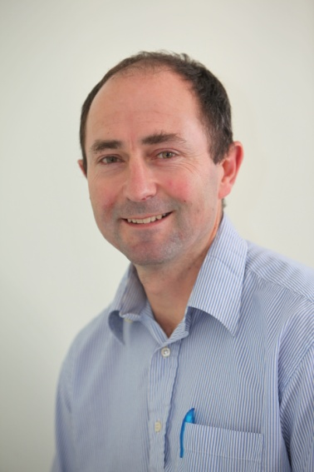
Anthony Rossiter
Department of Automatic Control and Systems Engineering
University of Sheffield
www.shef.ac.uk/acse
© 2014 University of Sheffield
This work is licensed under the Creative Commons Attribution 2.0 UK: England & Wales Licence. To view a copy of this licence, visit http://creativecommons.org/licenses/by/2.0/uk/ or send a letter to: Creative Commons, 171 Second Street, Suite 300, San Francisco, California 94105, USA.
It should be noted that some of the materials contained within this resource are subject to third party rights and any copyright notices must remain with these materials in the event of reuse or repurposing.
If there are third party images within the resource please do not remove or alter any of the copyright notices or website details shown below the image.
(Please list details of the third party rights contained within this work.
If you include your institutions logo on the cover please include reference to the fact that it is a trade mark and all copyright in that image is reserved.)

